Slide 1


Cluny Primary School
Our Cluny promise

Slide 2

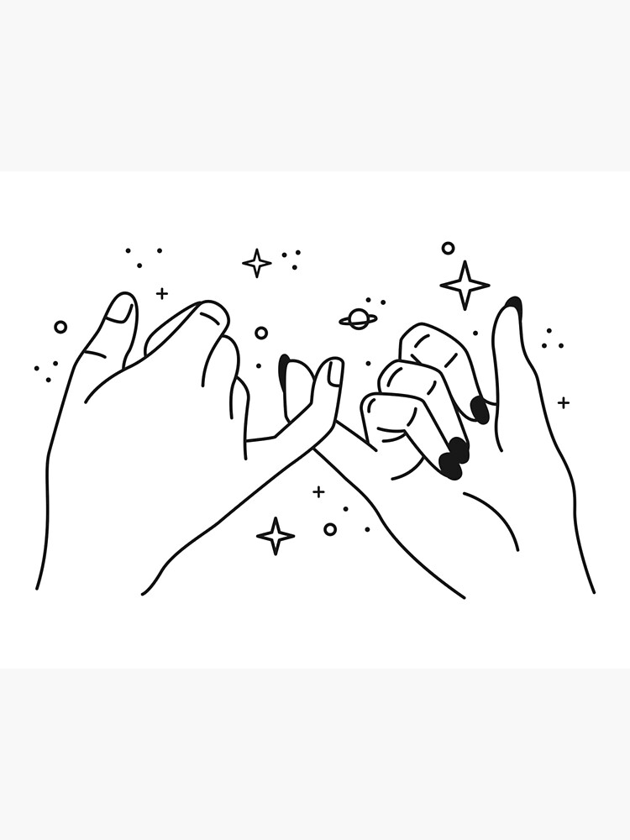
The Cluny Promise
Our Cluny promise is to treat others the way we would like to be treated.

Slide 3
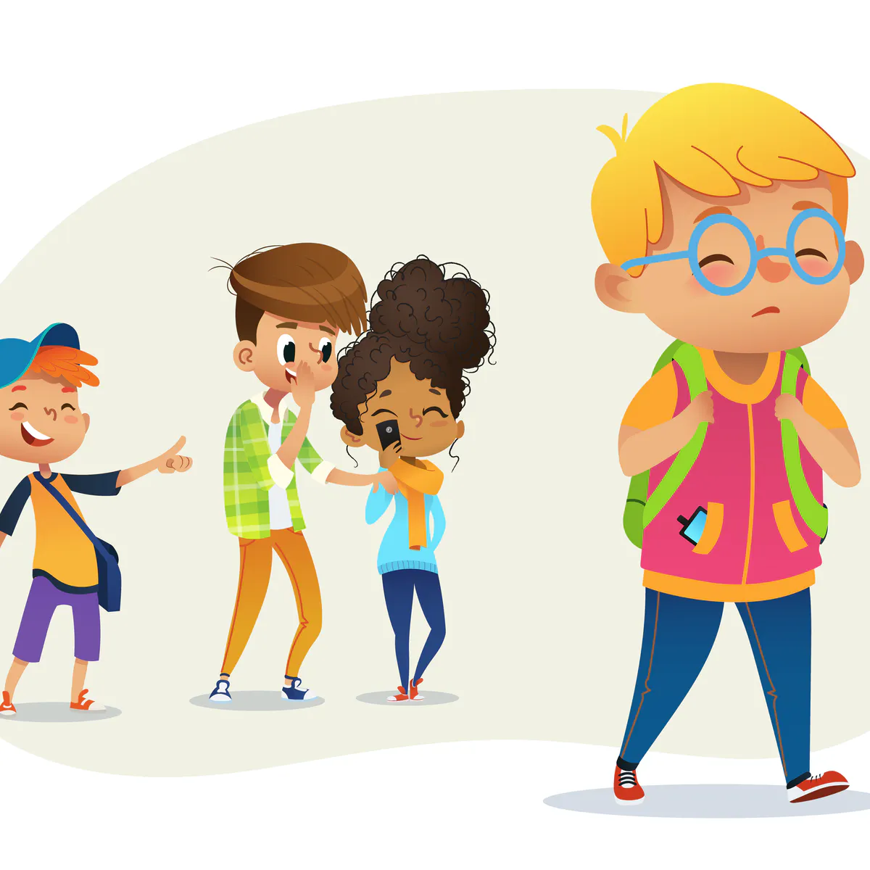
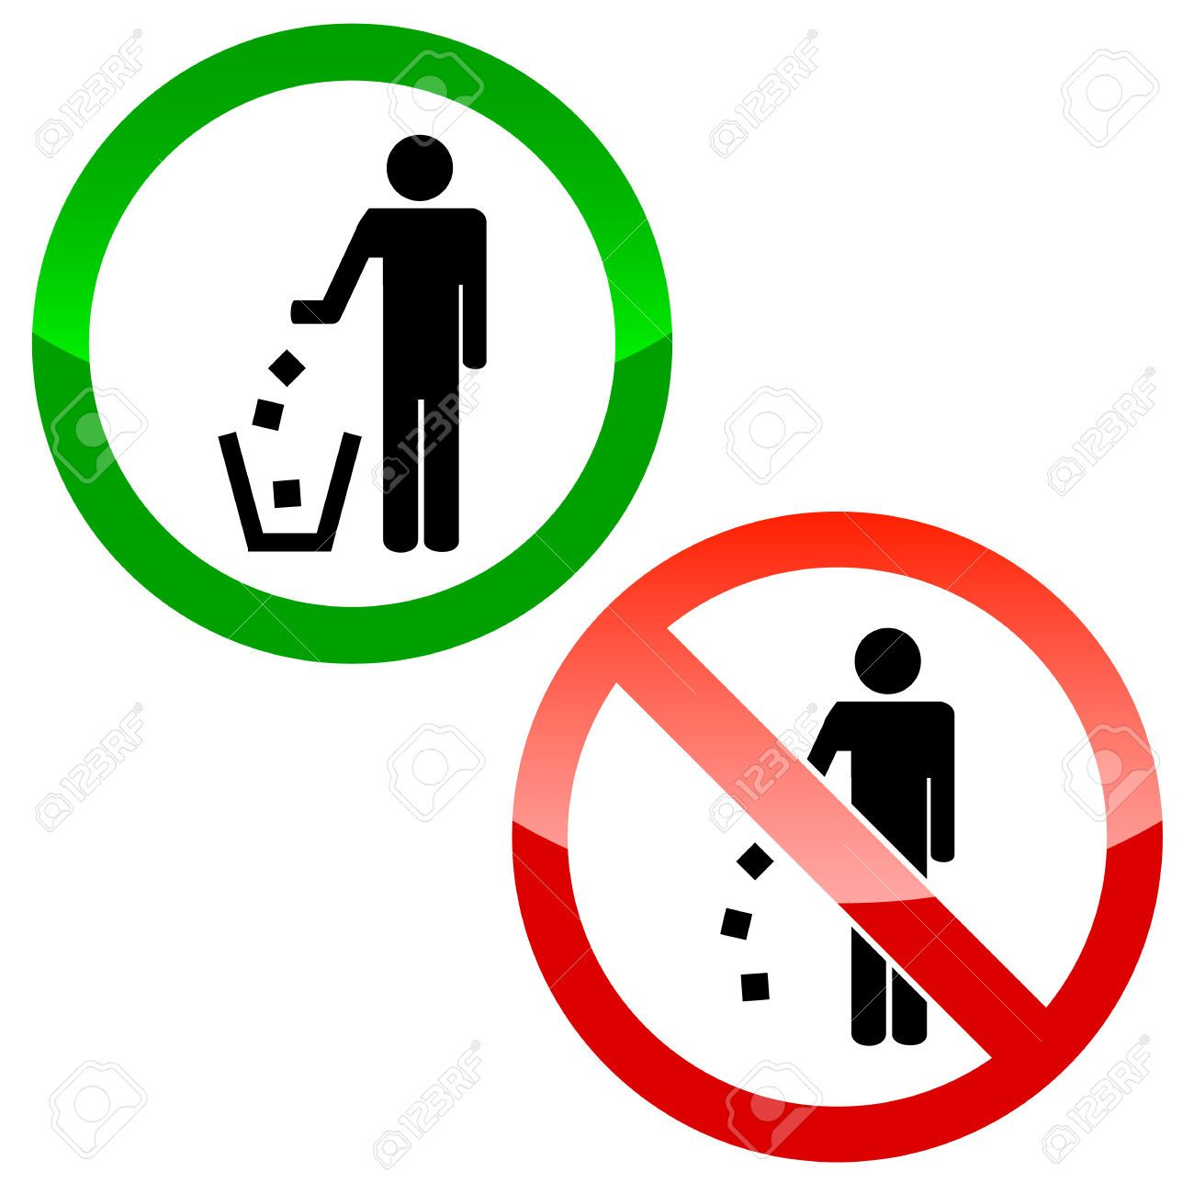
Respect
Respect is about being kind and bullying is a big problem we should be nice to everyone around us. But Respect isn’t just about being kind we should remember to pick up our litter if we accidentally drop it and put it in the bin.

Slide 4
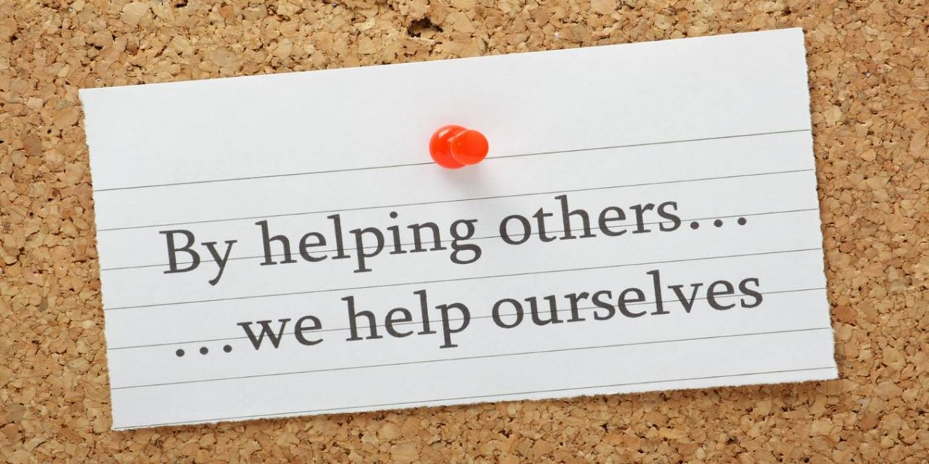
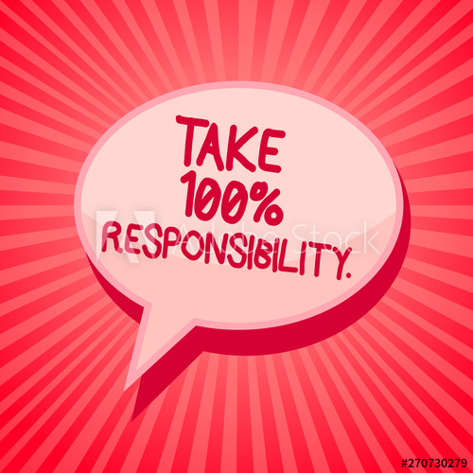
Our Responsibilies
to show our responsibility's to teachers students and adults we can line up smartly, don’t litter, follow the rules and help others. being responsible is not just about being smart you need to be fun, active and kind

Slide 5
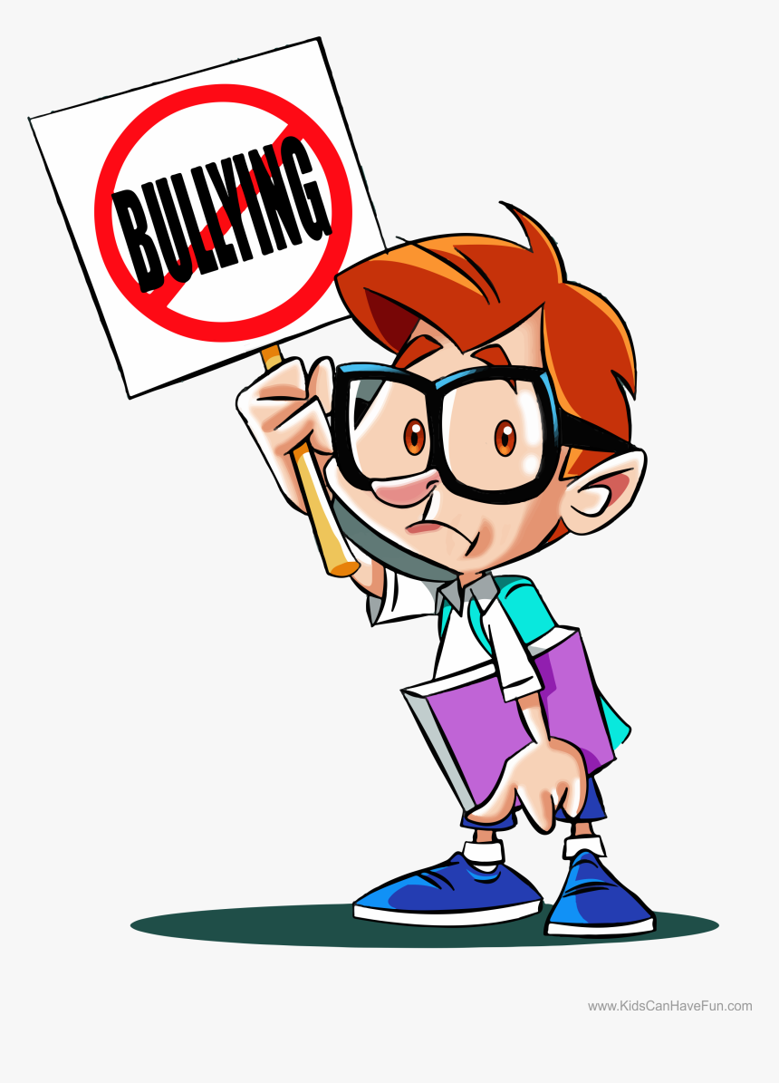
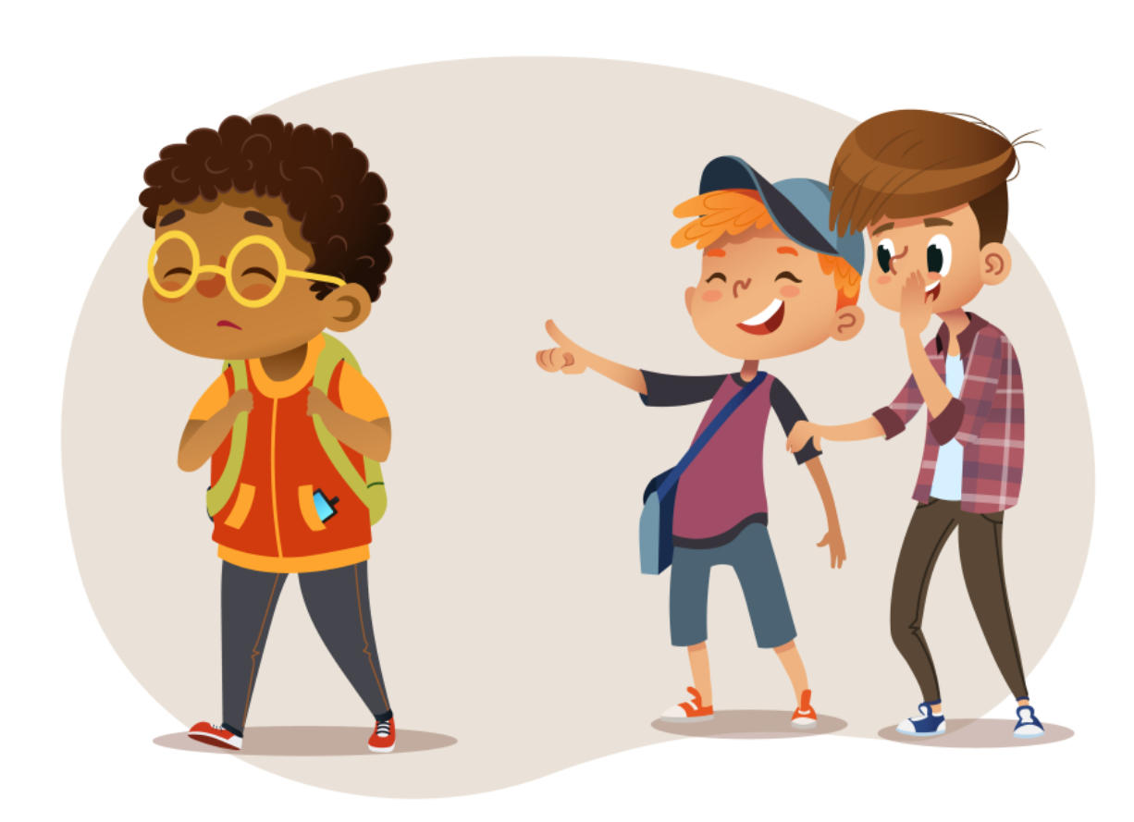
Bullying
Bullying is bad it can hurt peoples feelings and make them sad,
upset or unhappy which is not nice feelings .You can make people
feel like this by calling them names or hurting them .

Slide 6
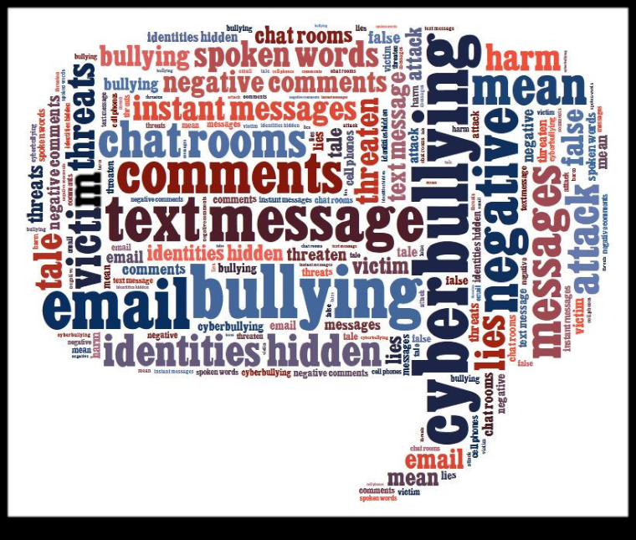

Cyber bullying
Cyber bullying is bullying online. This mostly happens on apps like snapchat, Facebook, Instagram, tiktok or WhatsApp. And this is a serious problem that has to stop. Bullying happens mostly everyday people are getting so hurt by this each nasty comment people get more sad
Notes:
Leads to

Slide 7
And that’s our Cluny promise

