Slide 1
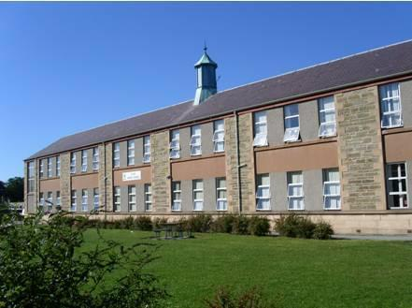
Cluny Primary Promise

Slide 2
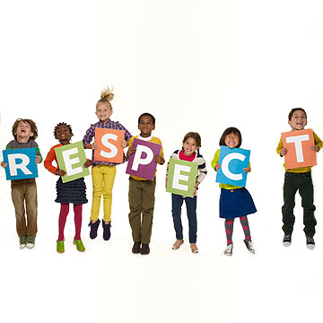
Our Cluny Promise is to treat others the way we would like to be treated ourselves.
We respect our school by coming in with our uniform on, respecting teachers and helping others.

Slide 3
In Cluny Primary we do not swear, bully, fight, be rude towards staff and others and don’t litter.
Cluny Primary is a wonderful school to go to, it is positive. You will be loved, cared and respected because Cluny Primary is the best place to be!
In Cluny Primary we respect staff and others, we pick up litter, we help others, we go to a teacher if anything happens and we behave.

Slide 4

If you aren’t being respected then you should walk away or tell an adult near by.
If it doesn’t change within a few day tell your mum dad or carer to phone into the school and the head or deputy head teacher will have a talk with you and that person!

Slide 5

Mostly everyone tries to get along with one another which is wonderful and all but you never know what could happen! You could become best friends but sometimes your friendship can break apart which is sad.
People don’t always get along but its good to make a friend, your friend doesn’t always become your best friend but its good if he or she does become your best friend! It’s at that point when your friend moves on but maybe he or she needed a break.

Slide 6

Friends love each other but not love love. Love is a strong word that can be used for a best friend but its true you love your best friend more than anything in the world.
The best thing about having a best friend is that there always there for you, they care for you, they make you laugh when your having a tough time and the best thing is that they go to Cluny Primary School.

Slide 7

Respect in Cluny Primary is not like any other respect we respect everyone in our school even if you don’t like them. If someone is felling upset or alone we help them out and ask them to come play with us. We are always kind to one another because we want to be treated the way they would like to be treated. The Cluny Promise is to remind us how we would feel to upset like the others.

Slide 8

Cluny Primary needs to take a lot of responsibility especially the Primary 7’s. With responsibility that means you need to be kind, helpful, respectful and caring.

Slide 9

Cluny Primary does not tolerate inappropriate language.
Inappropriate language is a really bad thing at Cluny Primary because you can get into some really big trouble. Swearing is banned in most schools but in Cluny Primary swearing doesn’t exist.

Slide 10
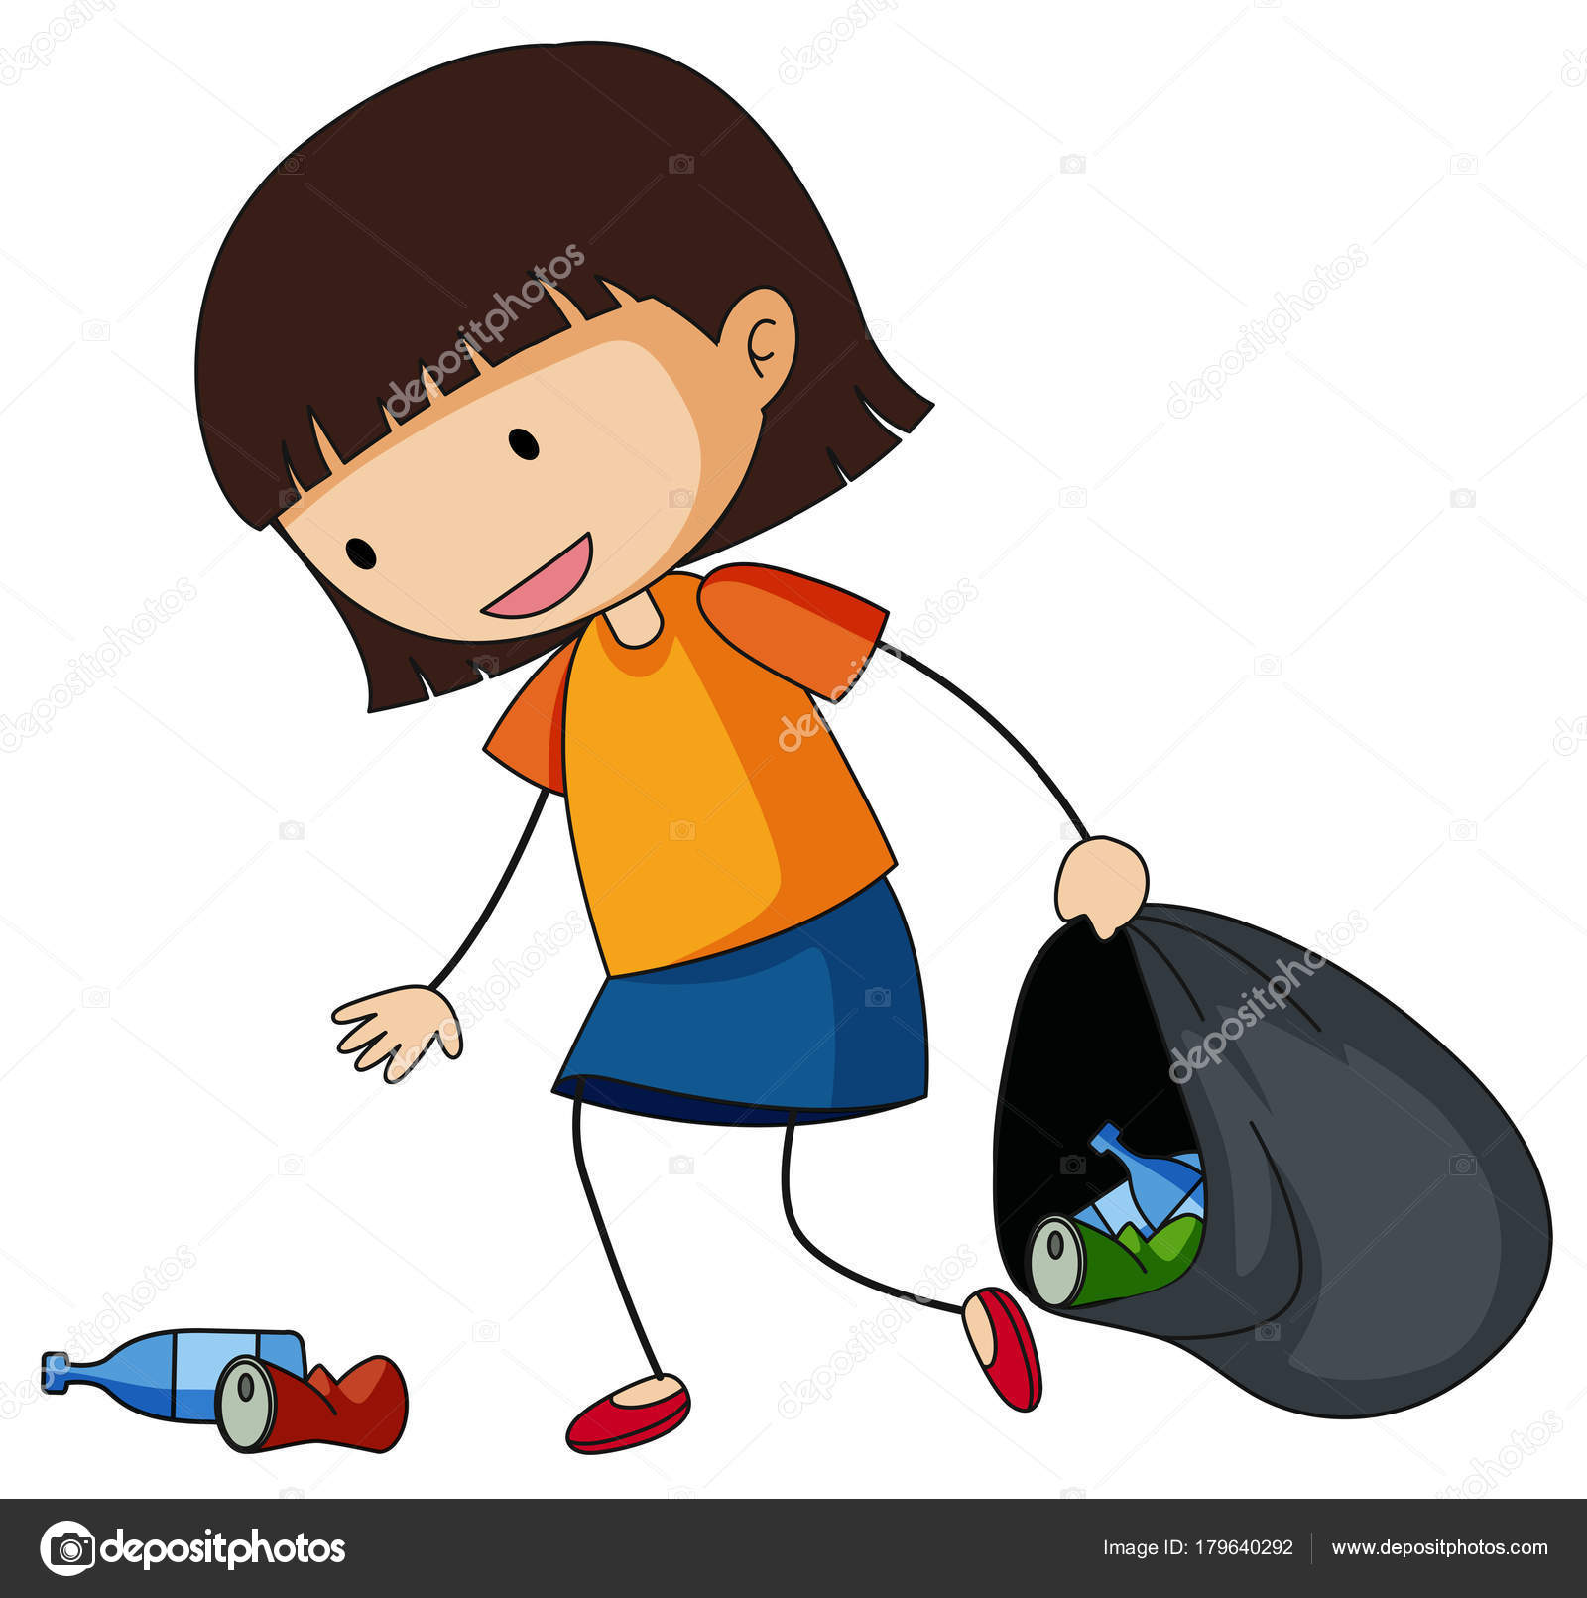
Littering is not the right thing to do. If you see someone littering tell them to pick it up and if they refuse tell a teacher or do it for them.
Littering in Cluny doesn’t set a good example it sets a bad
example because it influences other children to do it.

Slide 11
Cluny Primary is the place to be!

