Slide 1

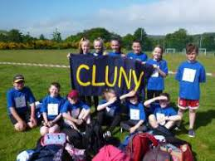
Cluny Primary School
☺ Respect and Responsibilities ☺
Respect and responsibilities ☺

Slide 2
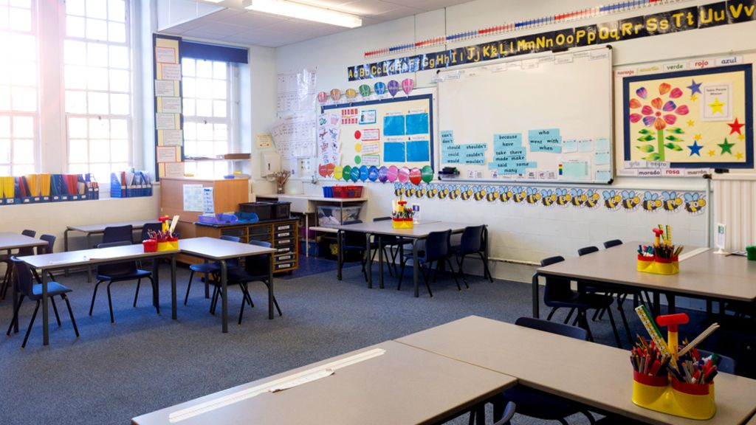
Responsibilities in school and in the community.
What ?
picture
In school we should tidy the classroom and put all of our belongings in our bags.
In our community we should be responsible for our litter we should put it in the bin when we are finished.

Slide 3
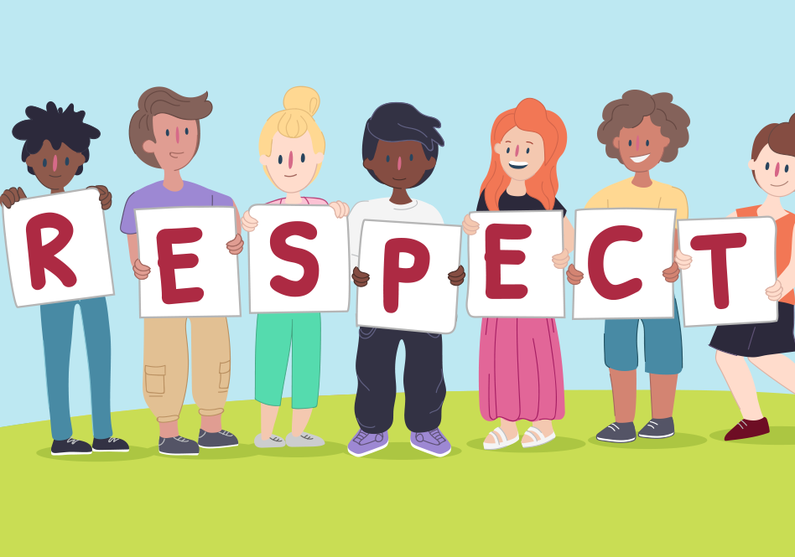
Respect in school and in our community Respect means admiration for a person or a things good qualities.
In school we should listen to the teachers. We should not litter in the playground and also not to use bad langue to staff and teachers. We should be a role model to our primary ones.
In the community we should not litter. At parks we should not vandalise the property. We should let others have a go on the things there.

Slide 4
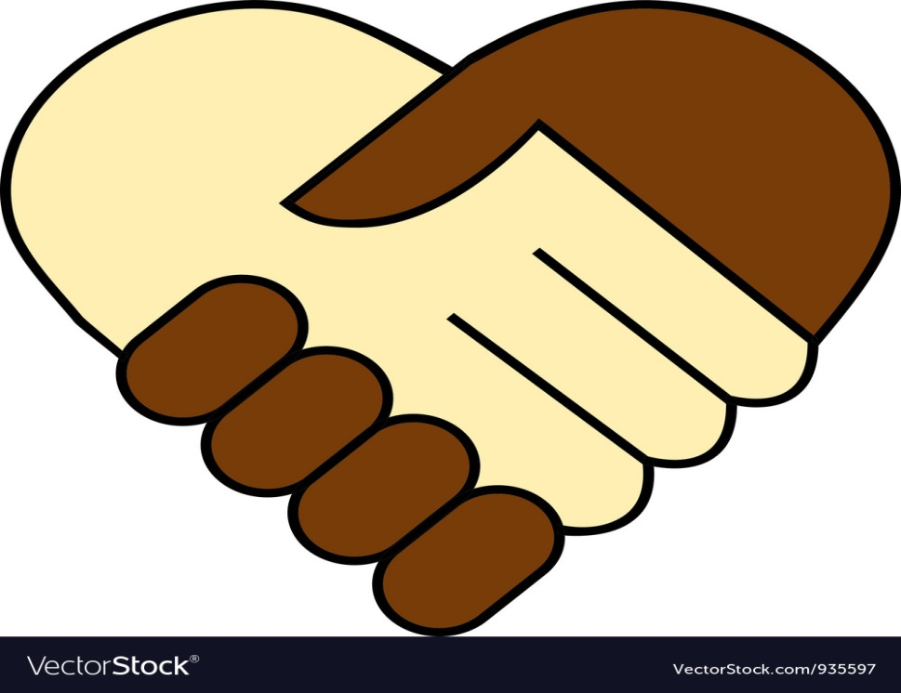
The Cluny Promise
The promise
Picture
In our school we promise to try to treat others the way we would like to be treated ourselves.

Slide 5
video about respect and some writing ☺
Responsibilities as a primary 7
The video
.as a primary seven are responsibilities are…
.we have to set a good example for all the younger pupils.
.Here is a video clip of what respect is.
https://www.youtube.com/watch?v=dyZP5ppcBOg

Slide 6

What should we do if somone disrespects us
What should we do if someone disrespects us ? ☹
What we should do
Picture
If someone disrespects us we should not retaliate and go tell an adult
Don’t ever copy other peoples bad behaviour .
And don’t talk back to any teachers

Slide 7
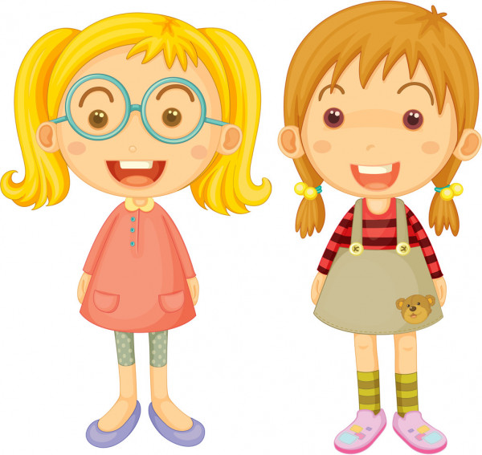
We hope you enjoyed our power point by Emilie and Eilidh ☺.thanks for watching

