Slide 1



Our Bronze Award
We have achieved our Bronze Rights Respecting School Award – here are all the things we have done to achieve it.
This PowerPoint has been created by the RRS group.

Slide 2
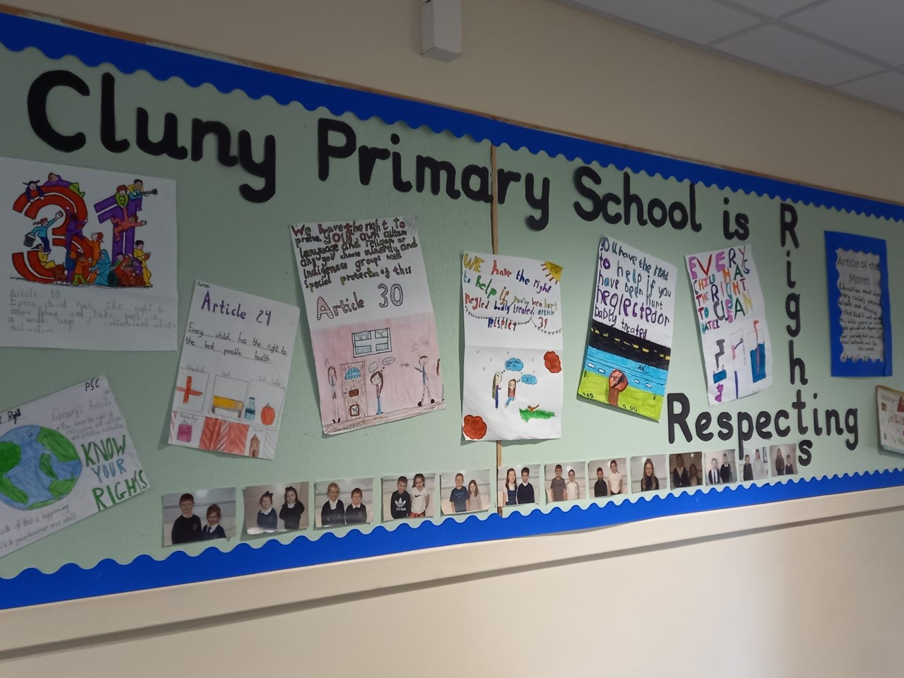
Our rights respecting school group
We have a Rights Respecting School group which is made up of representatives from each class – from P1 to P7. They meet every two weeks and share these meetings with their classes.
We have a Rights Respecting School display board to keep everyone updated with all the busy work the school have been doing.

Slide 3
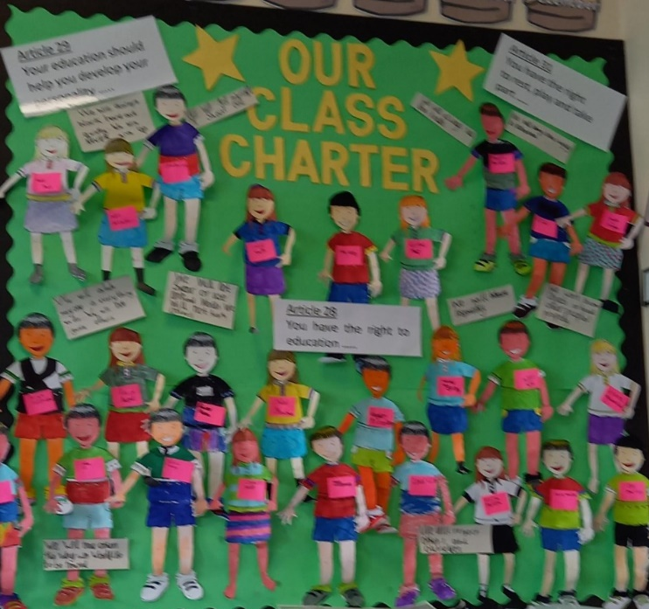
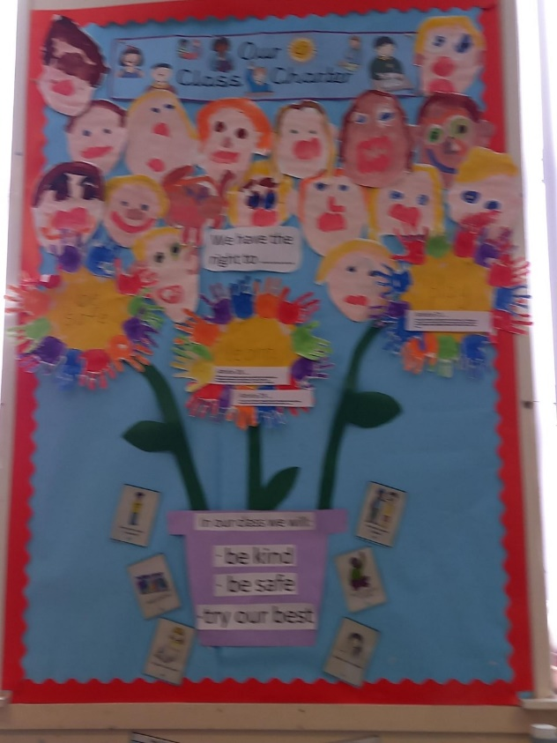
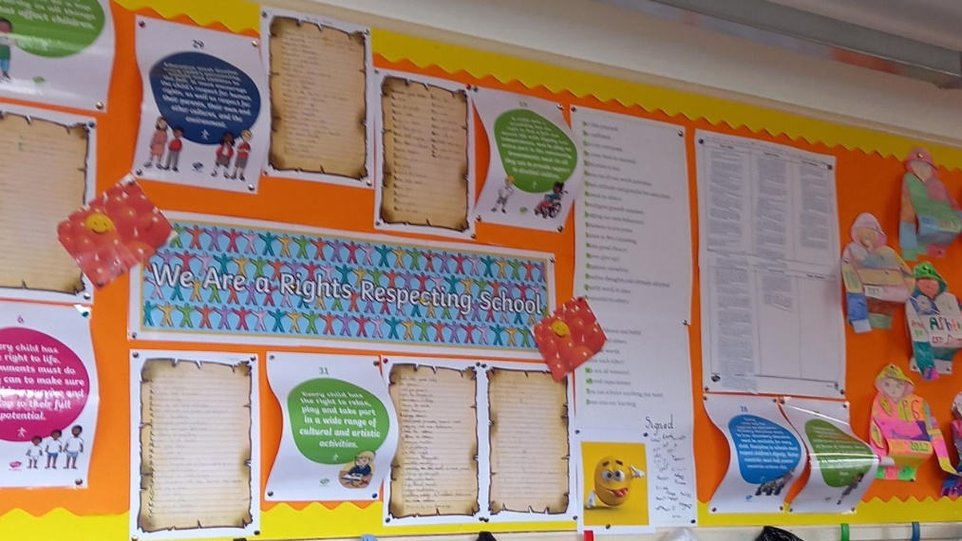
Class Charters
Every class has made their very own Class Charter which is displayed in their classroom. These are all linked to the UN Rights of the Child.

Slide 4
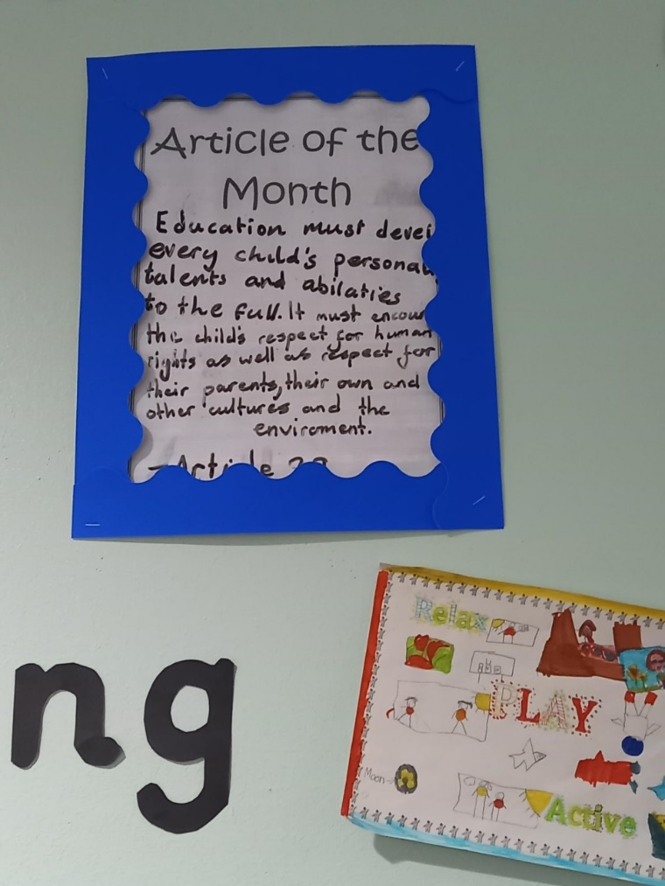
Article of the month
We have an Article of the Month which we display in the school and that we discuss during assembly and in class.

Slide 5
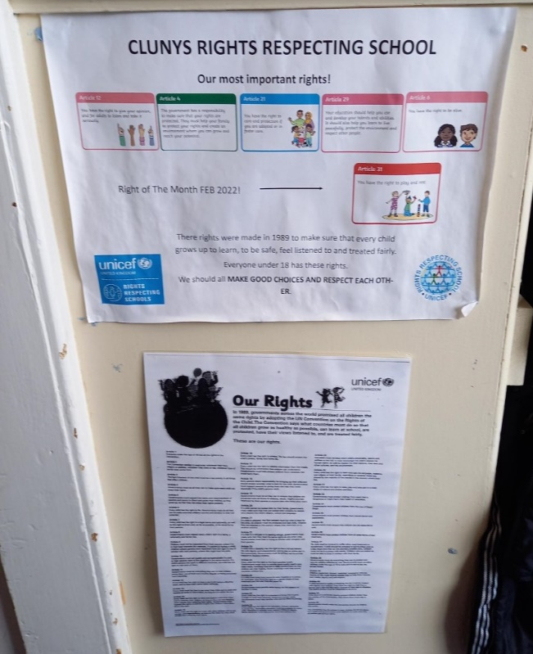
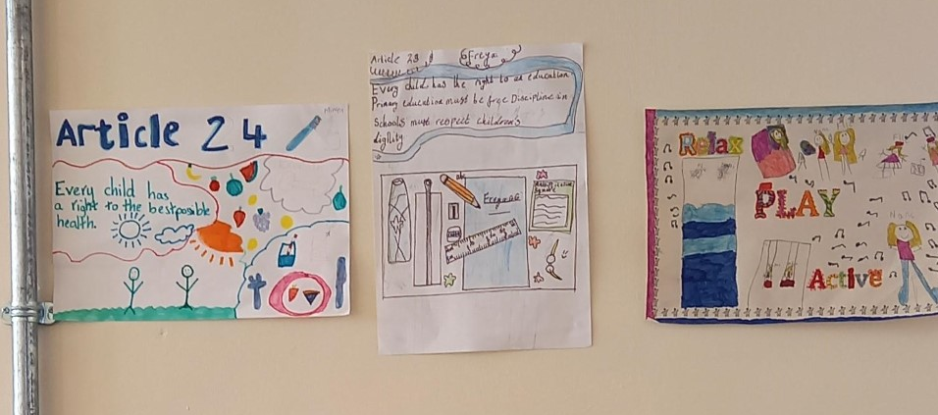
Posters
Different classes made posters of different articles and the Rights of the Child. These are displayed around the school.

Slide 6

Well done Cluny primary school!!
We are very proud to have received our Rights Respecting School Bronze Award. We are now working on achieving our Silver Award – watch this space!
‘We’ve all got Rights’ song from Unicef
https://www.youtube.com/watch?v=LN_70HXxd5Y

